Slide 1
Convolutional Neural Networks (CNN) Part 3
D E P A R T M E N T O F C O M P U T E R S C I E N C E U N I V E R S I T Y O F C O P E N H A G E N
Søren Olsen

Slide 2
Popular CNN-modules
Image classification, Object detection and Segmentation
Loss functions
AlexNet
VGG11-16-19
ResNet
Feture Pyramid Networks (FPN)
R-CNN-family, Unet
Course Evaluation

Slide 3
Loss functions
The loss function determines the performance!
For regression use the sum of squared errors. This is a maximum likelihood estimate if the error is normally distributed.
For classification use cross-entropy error and one hot encoding if multiple classes. Often, a soft-max activation function is applied to make the output integrate to 1.0.
When bounding boxes and/or masks are to be estimated simultaneously, the loss function will be a composition.

Slide 4
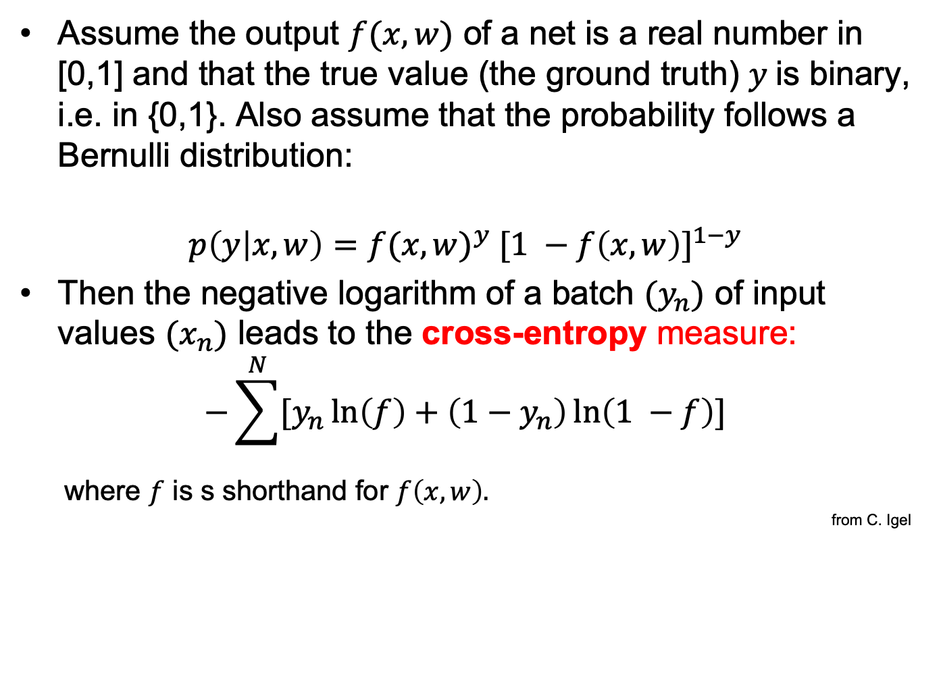
Loss function for binary classification
Assume the output $f(x,w)$ of a net is a real number in [0,1] and that the true value (the ground truth) $y$is binary, i.e. in {0,1}. Also assume that the probability follows a Bernulli distribution:
$$p\left(y | x,w\right)={f(x,w)}^{y} {[1 −f\left(x,w\right)]}^{1−y}$$
Then the negative logarithm of a batch $(y_{n})$ of input values $(x_{n})$ leads to the cross-entropy measure:
$$−\sum^{N}{[y_{n}\ln\left(f\right)+\left(1−y_{n}\right)\ln\left(1 −f\right)]}$$
where $f$ is s shorthand for $f\left(x,w\right).$
from C. Igel

Slide 5
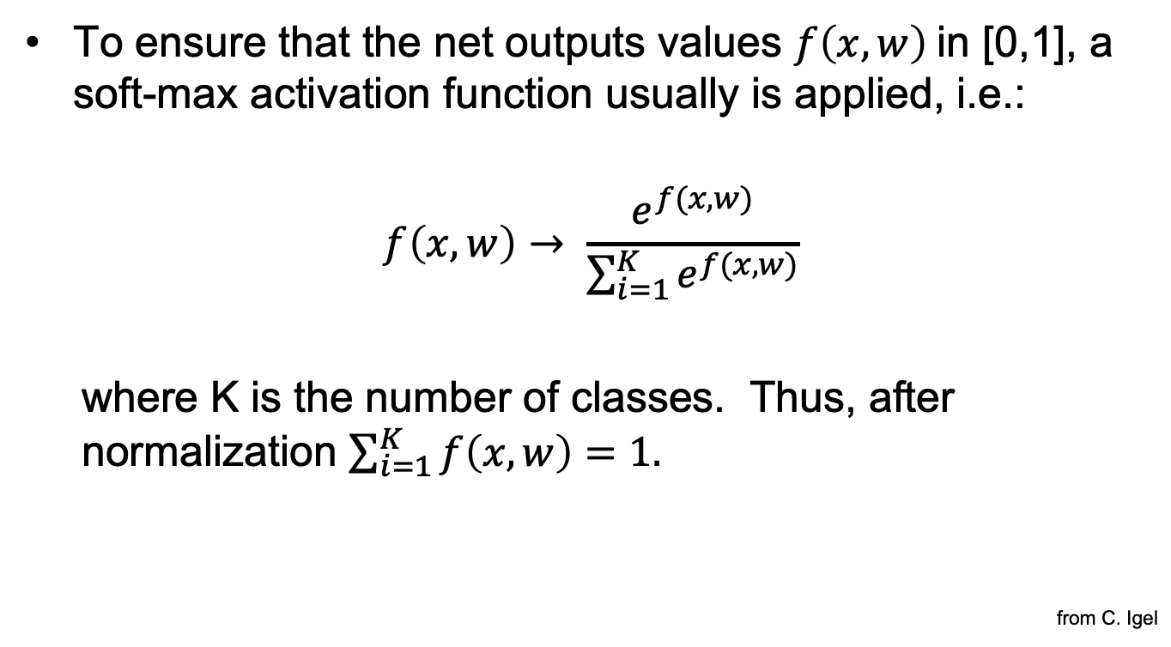
Soft-max
To ensure that the net outputs values $f\left(x,w\right)$in [0,1], a soft-max activation function usually is applied, i.e.:
$$f\left(x,w\right)→ \frac{e^{f(x,w)}}{\sum_{i=1}^{K}{e^{f(x,w)}}}$$
where K is the number of classes. Thus, after normalization $\sum_{i=1}^{K}{f\left(x,w\right)=1.}$
from C. Igel

Slide 6
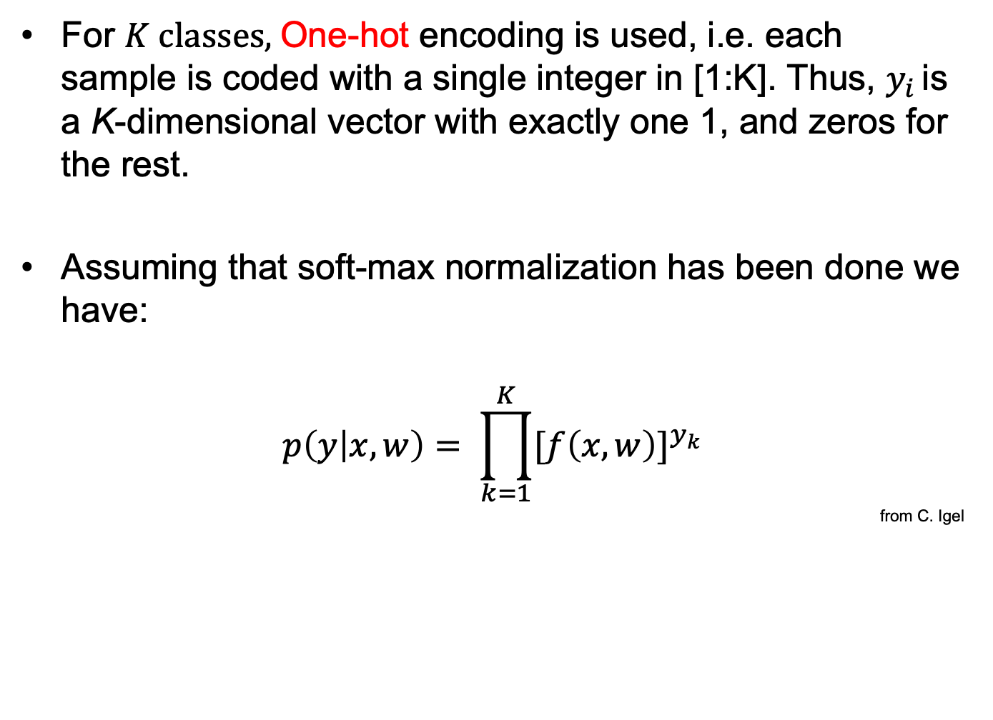
Multi class classification
For $K classes,$One-hot encoding is used, i.e. each sample is coded with a single integer in [1:K]. Thus, $y_{i }$is a K-dimensional vector with exactly one 1, and zeros for the rest.
Assuming that soft-max normalization has been done we have:
$$p\left(y | x,w\right)= \prod_{k=1}^{K}{{[f\left(x,w\right)]}^{y_{k}}}$$
from C. Igel

Slide 7
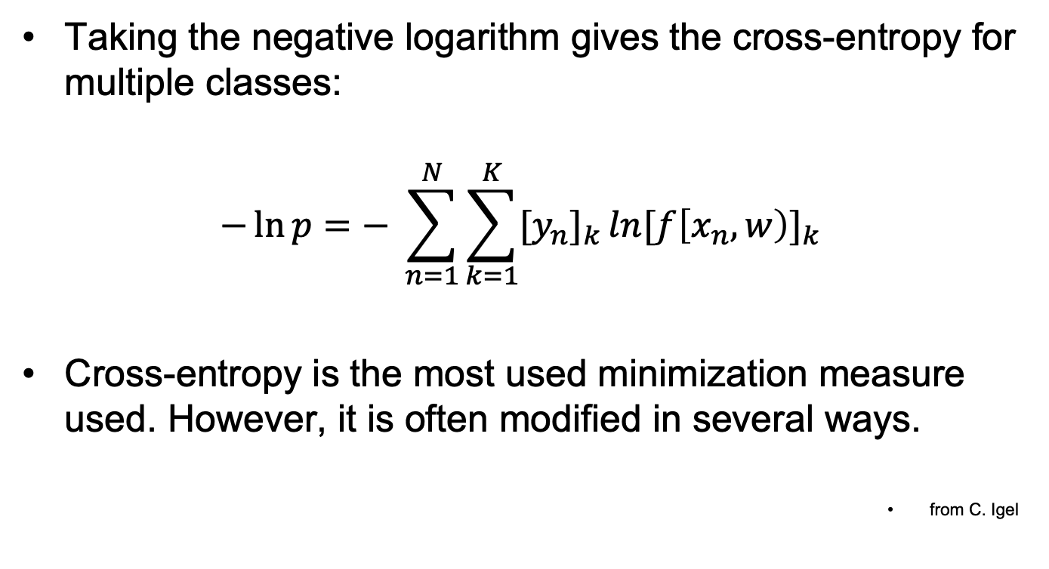
and further
Taking the negative logarithm gives the cross-entropy for multiple classes:
$$−\ln{p}=− \sum_{n=1}^{N}{\sum_{k=1}^{K}{{[y_{n}]}_{k }ln{[f\left[x_{n},w\right)]}_{k}}}$$
Cross-entropy is the most used minimization measure used. However, it is often modified in several ways.
from C. Igel

Slide 8
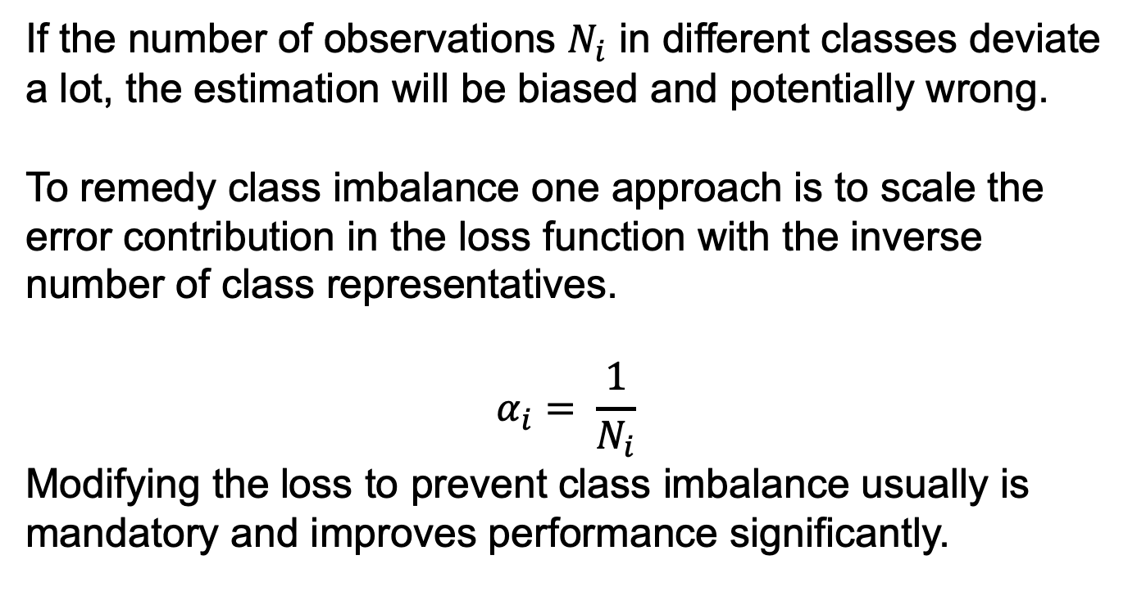
Class imbalance
If the number of observations $N_{i}$ in different classes deviate a lot, the estimation will be biased and potentially wrong.
To remedy class imbalance one approach is to scale the error contribution in the loss function with the inverse number of class representatives.
$$α_{i}= \frac{1}{N_{i}}$$
Modifying the loss to prevent class imbalance usually is mandatory and improves performance significantly.

Slide 9
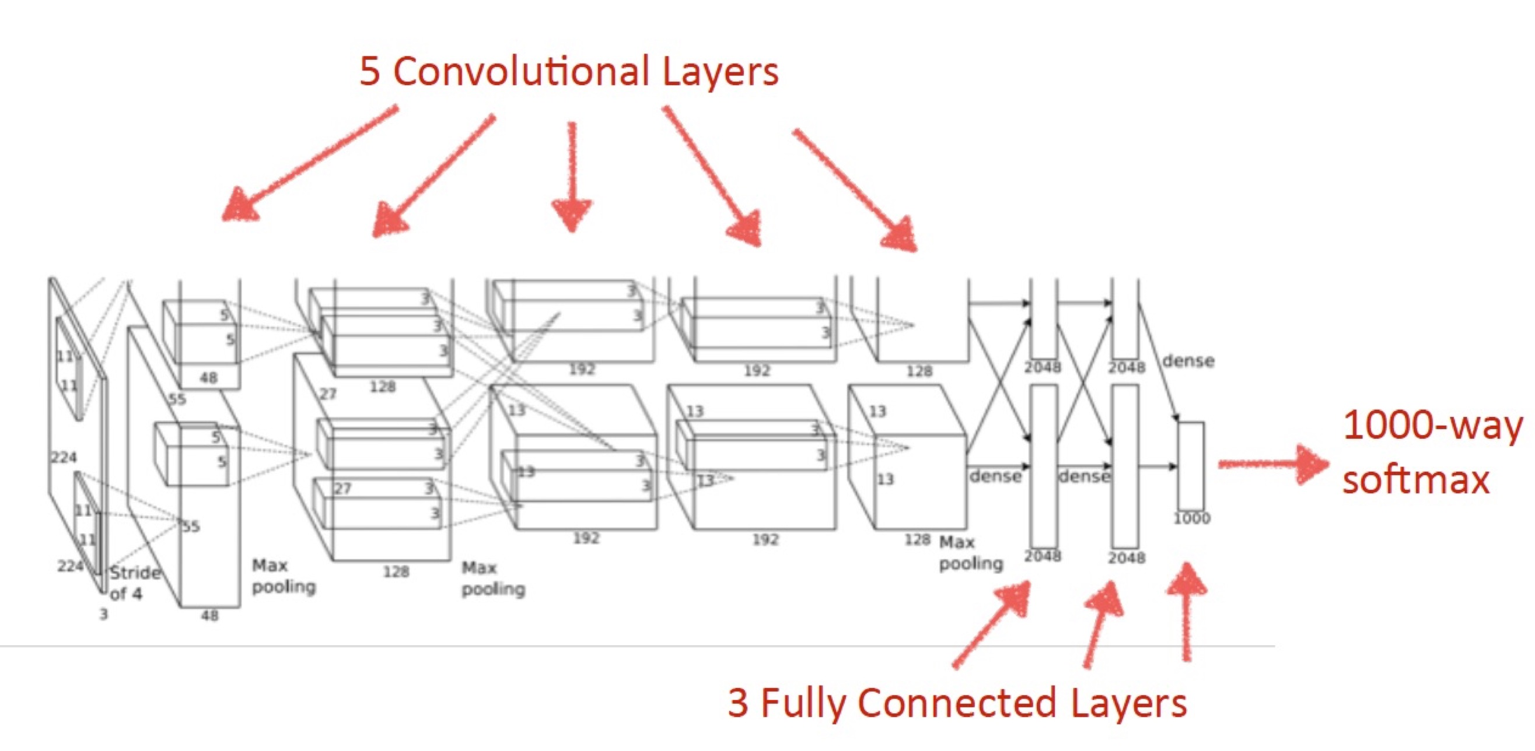
AlexNet

Slide 10
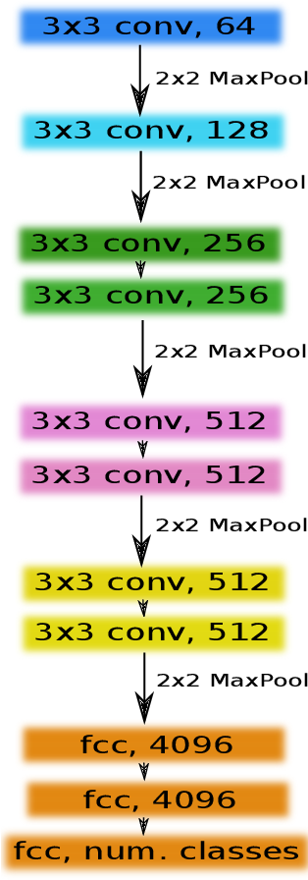
VGG family – VGG11

Slide 11

VGG-family VGG-16

Slide 12
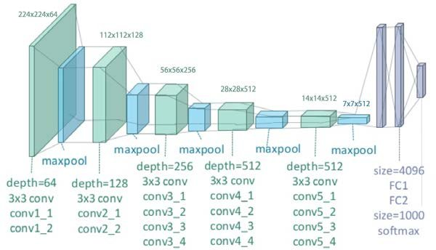
VGG-family VGG19

Slide 13
Vanishing gradient problem
Researchers found that for shallow nets, increasing the number of layers improved performance. For deeper nets, the performance decreased. The feature abstraction change will be slower.
The immediate consequence is that the training gradient becomes smaller between neighboring layers and tend to vanish.
In He, Zhang, Ren, Sun: Deep Residual Learning for Image Recognition a new Residual learning building block is proposed and shown to solve the vanishing gradient problem.

Slide 14
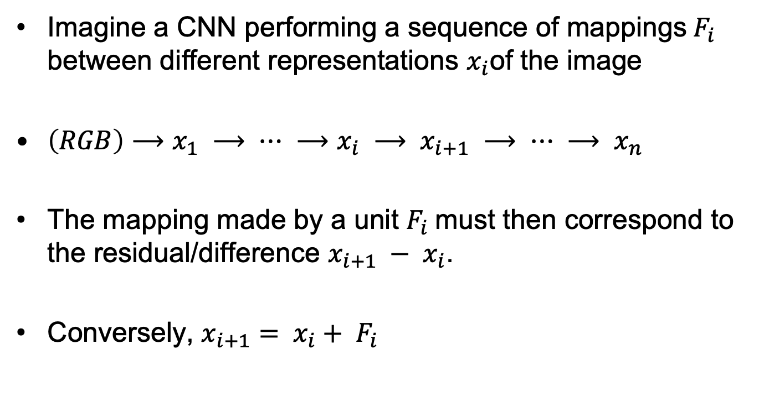
Residual building bloak
Imagine a CNN performing a sequence of mappings${ F}_{i}$ between different representations $x_{i}$of the image
$\left(RGB\right)⟶x_{1} ⟶ ⋯ ⟶x_{i} ⟶ x_{i+1} ⟶ ⋯ ⟶ x_{n}$
The mapping made by a unit $F_{i}$must then correspond to the residual/difference $x_{i+1} − x_{i}$.
Conversely, $x_{i+1}= x_{i}+ F_{i}$

Slide 15
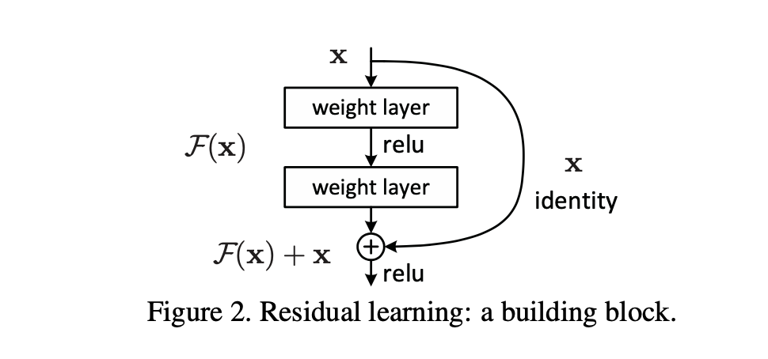
Residual building block
The residual building block is used in ResNet50, ResNet101 and
ResNet152 (reference networks) and is shown to work for a net with
1202 layers.
For very deep structures also, the Bottleneck building block is popular.

Slide 16
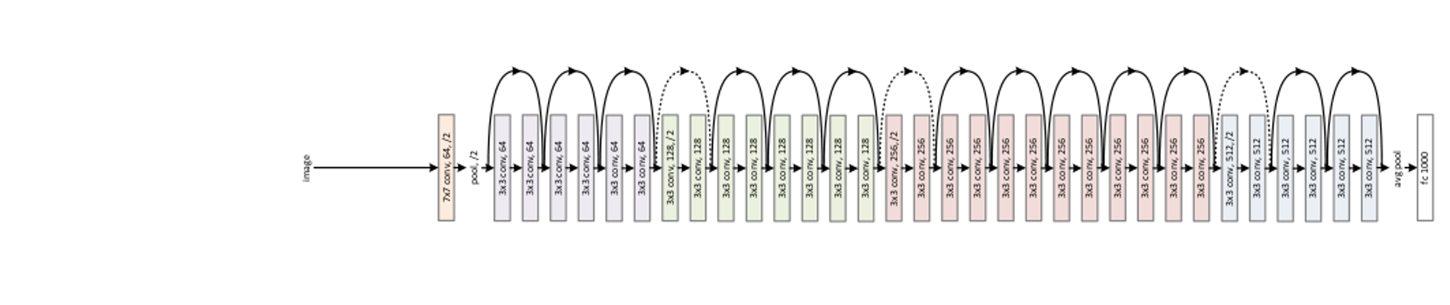
ResNet: ResNet34 (skipping, 18, 50, 101, 152, 1202)
Today, ResNet50, ResNet101 and Resnet152 serve as common backbone-net
in many applications.

Slide 17
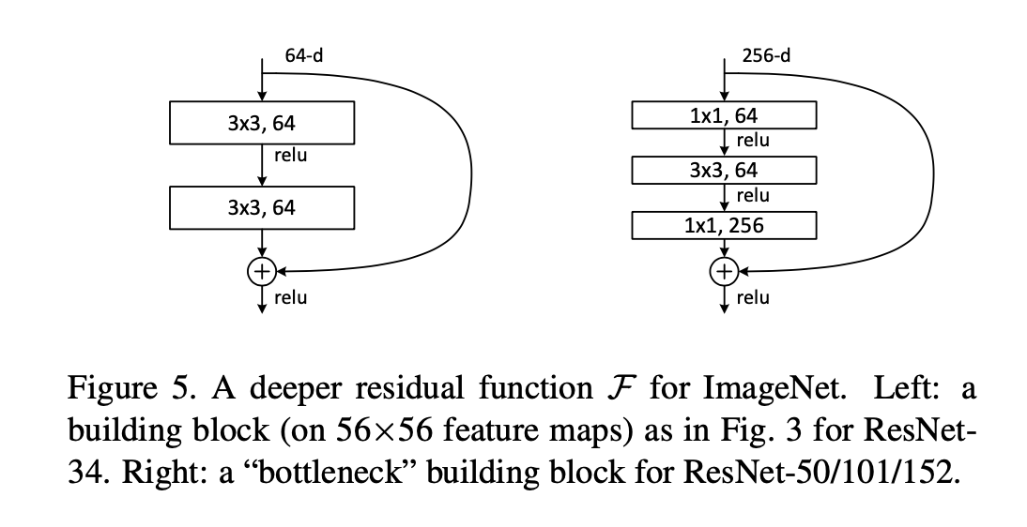
The Bottleneck building block
The bottleneck idea is to downscale the channel number before convolution
and upscale again after convolution. Here combined in a residual context.

Slide 18
Questions ?

Slide 19
Many other CNN constructions
We will skip a lot of contributions, including
Inception Net family
Squeeze and Exitation Net
DenseNet
R-FCN
DeepNet
Efficent Net
Yolo, SSD
etc.
Instead, we will end by sketching a few classical extensions for object detection and segmentation.

Slide 20
Feature pyramids
CNN’s build a pyramid of gradually more abstract, larger, and less well localized features.
Such representations do not allow detection of objects of significantly varying size.
Feature pyramids (Lin et.al: Feature Pyramid Networks for Object Detection, CVPR 2018) supplement by propagating global information backwards top-down through a pyramid.
Most modern methods apply a feature pyramid.

Slide 21
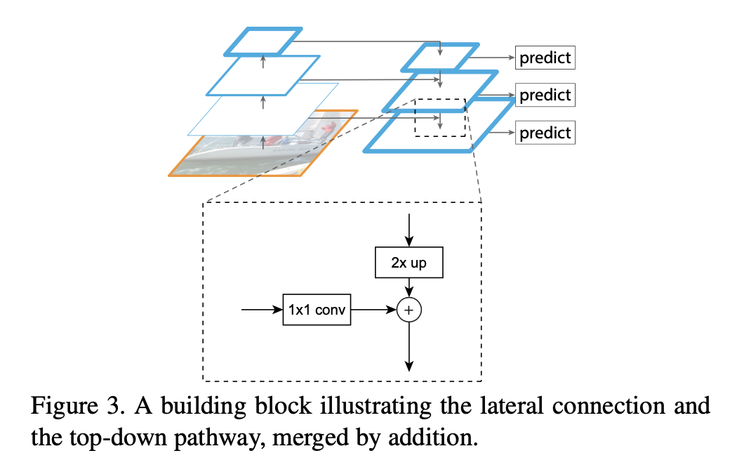
Building block for downwards propagation

Slide 22
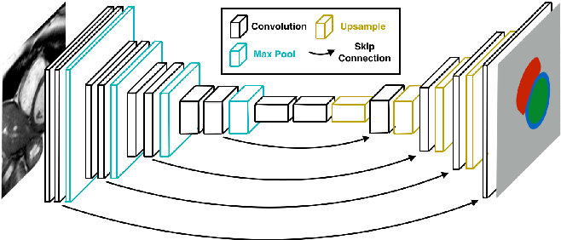
Skip connections
Skip connections may be done as in residual building blocks but may also span a larger range. In e.g. UNet information from the first levels is carried through
The combination of skip connections and upsampling (e.g. for use in
semantic segmentation) may be seen as an alternative to use of a
feature pyramid.

Slide 23
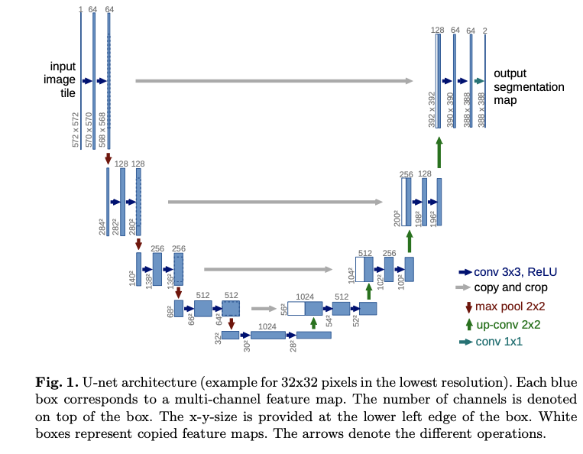
UNet

Slide 24
FPN or FCN ?
In Feature Pyramid Networks (FPN) all levels have the same number of channels, eg. 256.
It is argued that FPN performs better than Fully Convolutional Networks (FCN) as eg. in UNet.
In classification, FPN forms the input to another network: A Region Proposal Network (RPN).

Slide 25
R-CNN family (R = Region)
Girshick et.al.: Rich feature hierarchies for accurate object detection and semantic segmentation. CVPR, 2014. (R-CNN)
Girshick: Fast R-CNN. ICCV, 2015
Ren et.al.: Faster R-CNN: Towards real-time object detection with region proposal networks. NIPS, 2015.
He et.al.: Mask R-CNN. ICCV 2017

Slide 26
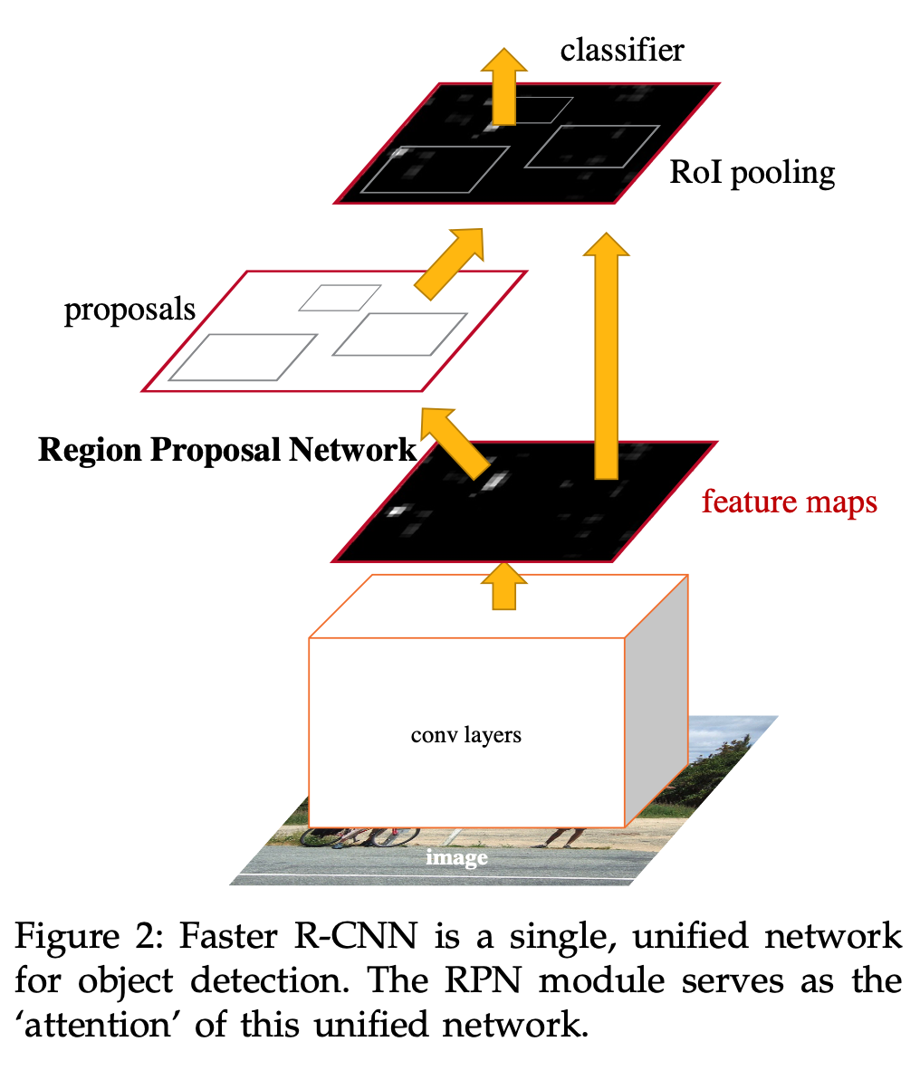
RPN- Region Proposal Network

Slide 27
Proposal Networks
The purpose of a proposal network is to generate hypotheses on object classes and object bounding boxes for a number of anchors.
An anchor is a possible object incarnation situated at position and determined by a size (the feature pyramid level) and an aspect ratio.
In Ren et.al.: Faster R-CNN: Towards Real-Time Object Detection with Region Proposal Networks a sliding window approach using 3 scales and 3 different aspect ratios results in approximately 2400 anchors

Slide 28
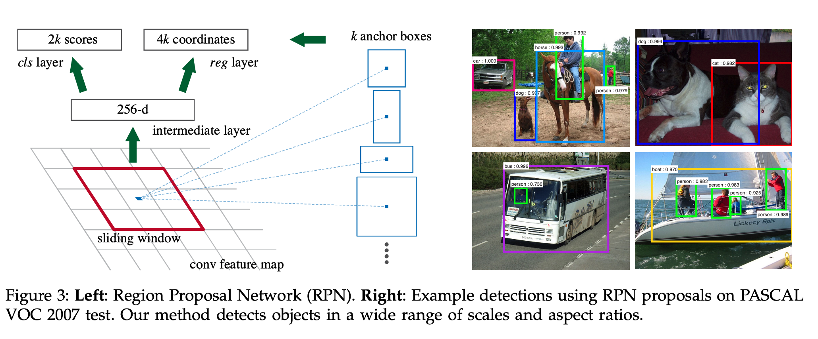
Anchors in Faster R-CNN
The classification head is constructed as a 2-class softmax layer. The scores
represent the probabillity of object or not (for each proposal). See paper for details.
k is the number of maximum possible proposals for each location.

Slide 29
ROI-align
ROI-align is a sampling technique used in mask-RCNN to extract a small feature map of a fixed size, e.g. 7x7. Simple bilinear interpolation is used, and harsh quantization avoided.
ROI-align is shown better than previous so-called ROI-Pool-, and ROI-Warp- approached applied in Faster RCNN and other approaches.

Slide 30
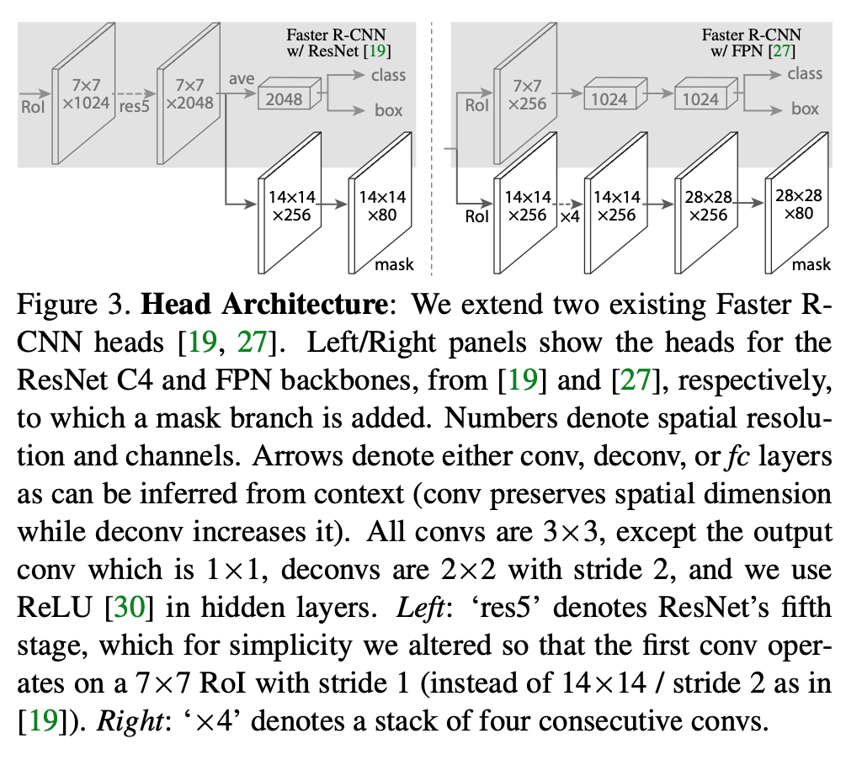
Network heads
In He et.al.: Mask R-CNN it is argued that classification, bounding box prediction and segment mask generation is best performed separately, but all based on a region proposal network.

Slide 31
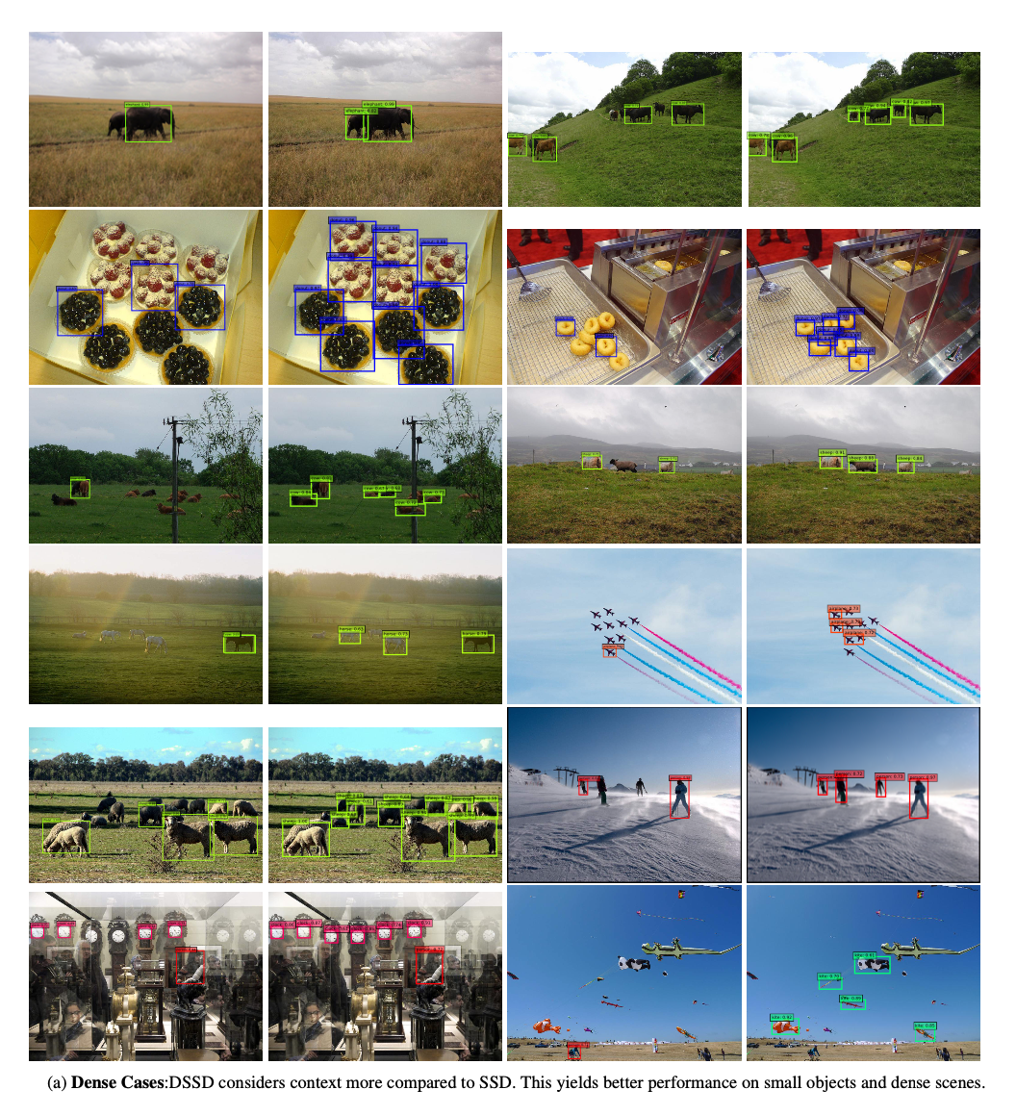

Slide 32
You Only Look Once (YOLO)
Redmon et al, 2016
In the paper, cell grid is 7 x 7 with B=2 bounding boxes per cell.
Therefore YOLO can only detect up to 98 objects in an image.
Notes:
But only 49 different object types.

Slide 33
YOLO: Examples of results
Redmon et al, 2016
Notes:
Second row, second image from left – the guy flying is misclassified as an aeroplane.

Slide 34
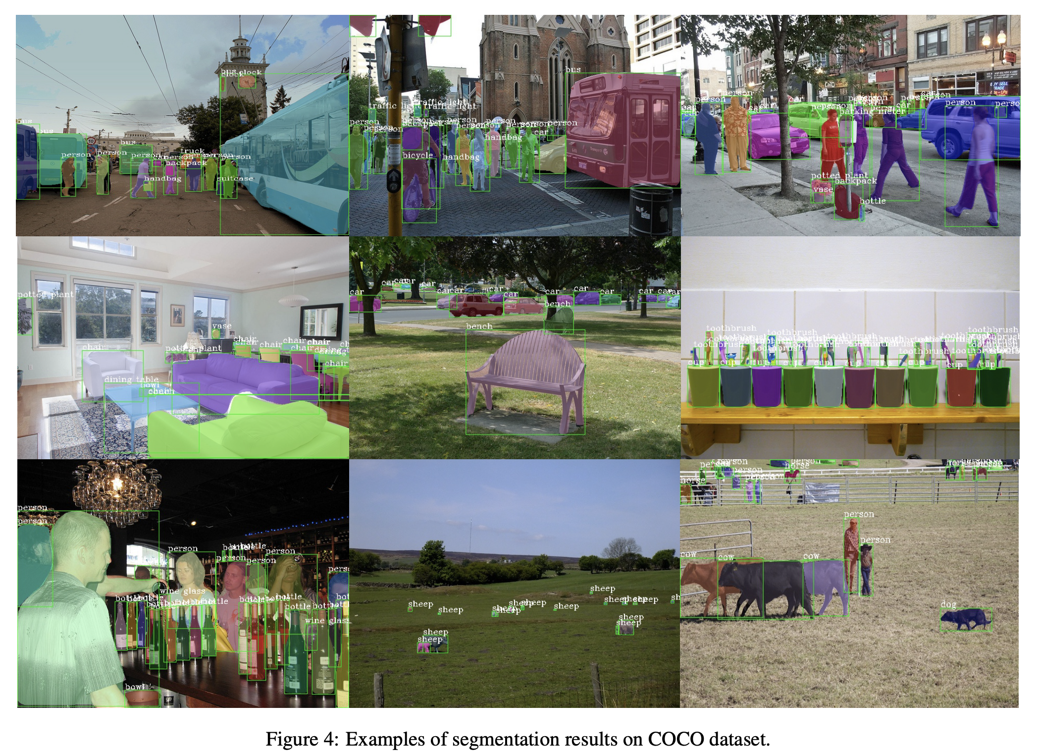
HTC results on COCO

Slide 35
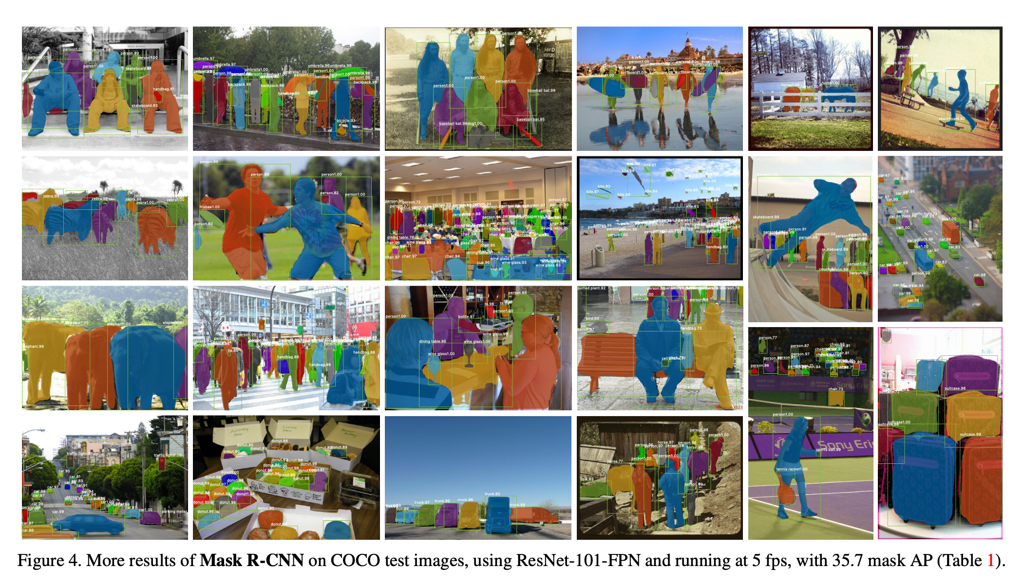
mask R-CNN results

Slide 36
NO MORE CNN
Questions (almost last chance)

Slide 37
Results from Evaluation
You think you work too hard, but you have hardly used the allocated time.
Many like the use of digital tools for teaching, but you are divided into two groups preferring online/physical teaching.
Lectures should be recorded, and more interactivity should be included in lectures. Slides should be uploaded before lectures.
Some wish more math intro or more programming examples/teaching.

Slide 38
Do you have any comments, further suggestions etc. before we close ?

Slide 39
Farewell
We hope that you will be able to use the techniques that we have been through.
Best wishes for your future study and life
Francois and Søren,
Navid, Steffen, Peidi

Slide 40
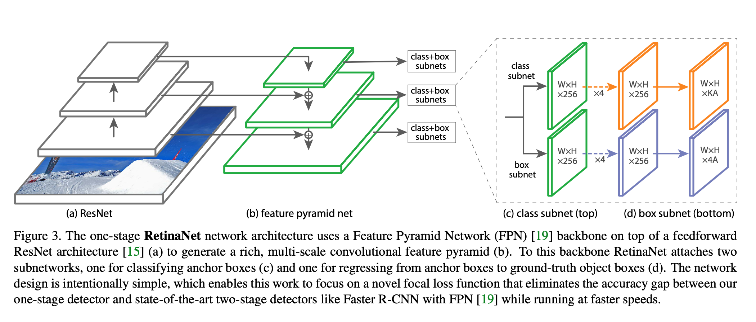
Retina net (one-stage detector)

